Slide 1
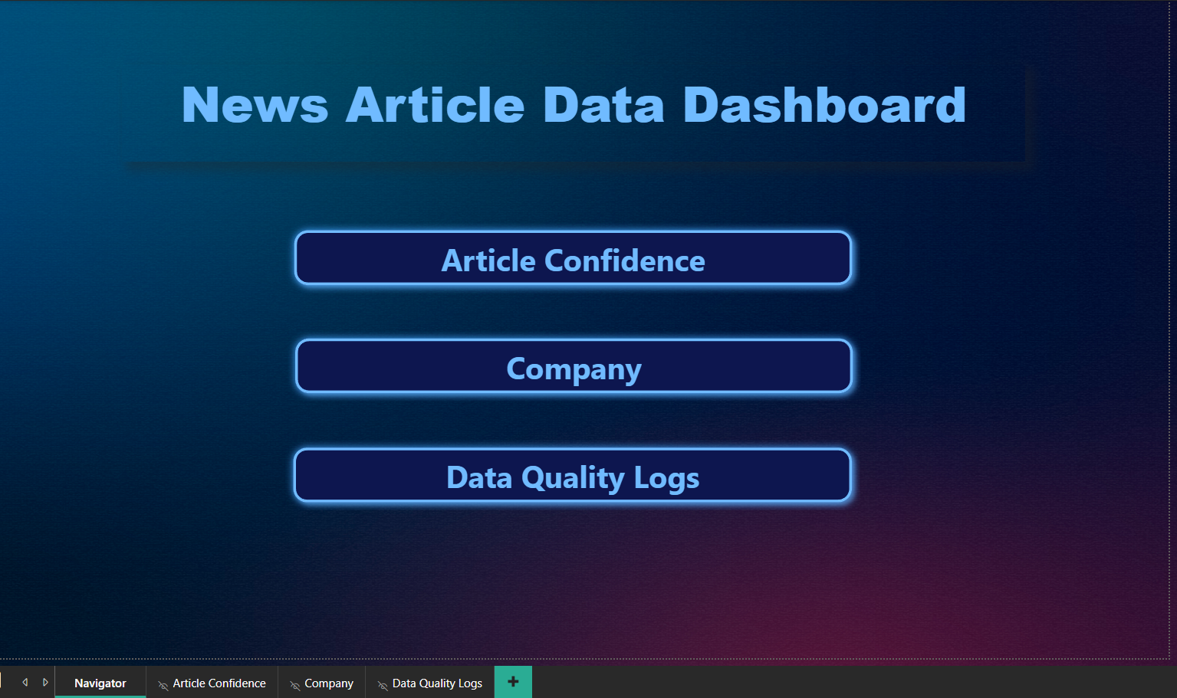

Slide 2
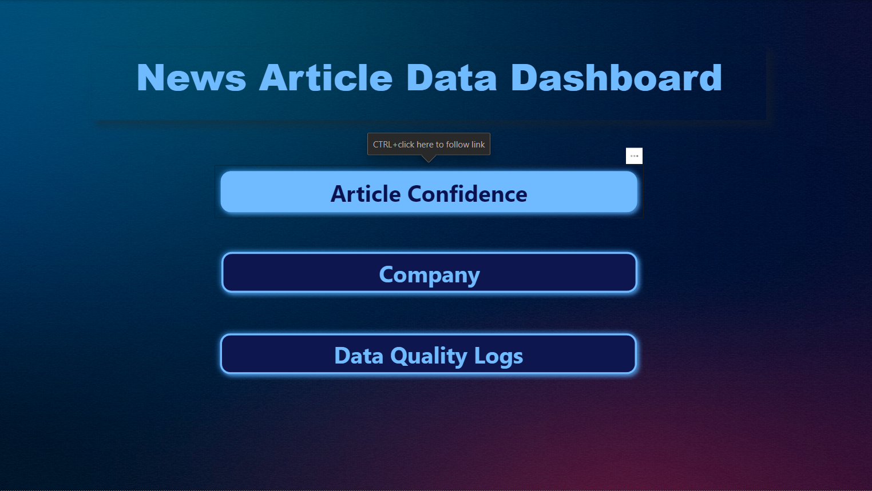
Click to Navigate to the desired sheet

Slide 3
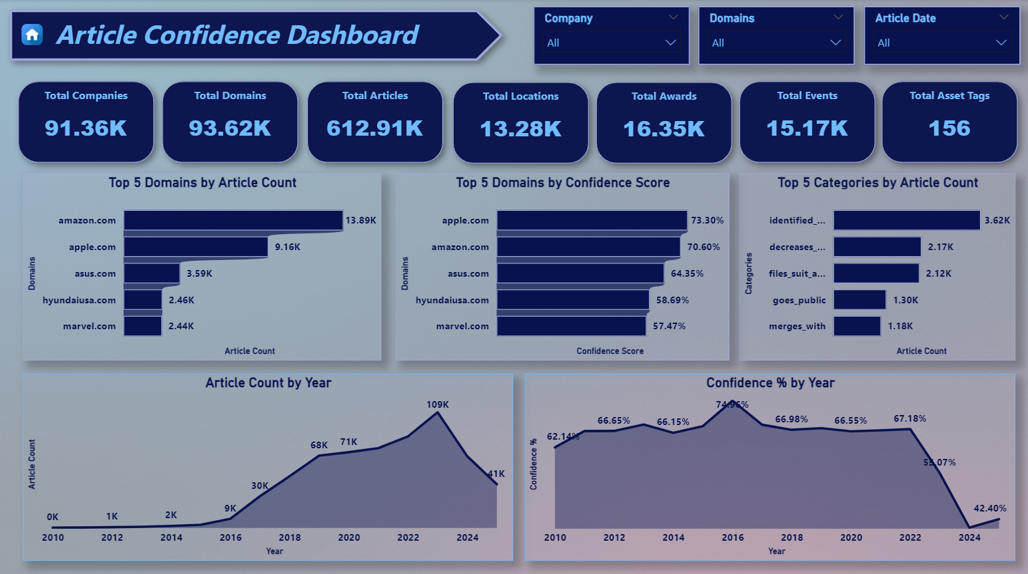

Slide 4
Click to Navigate to the Home Page

Slide 5
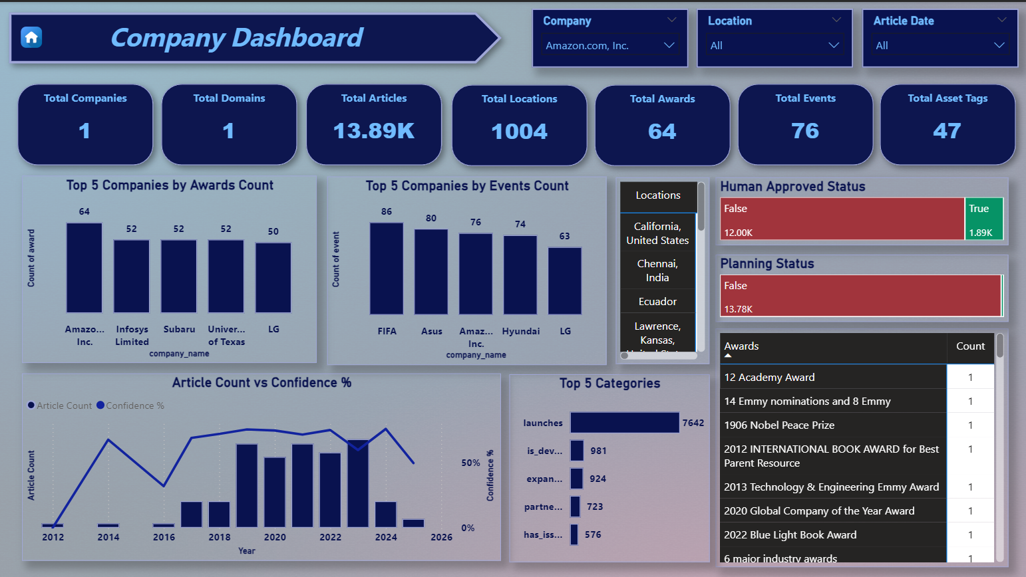

Slide 6
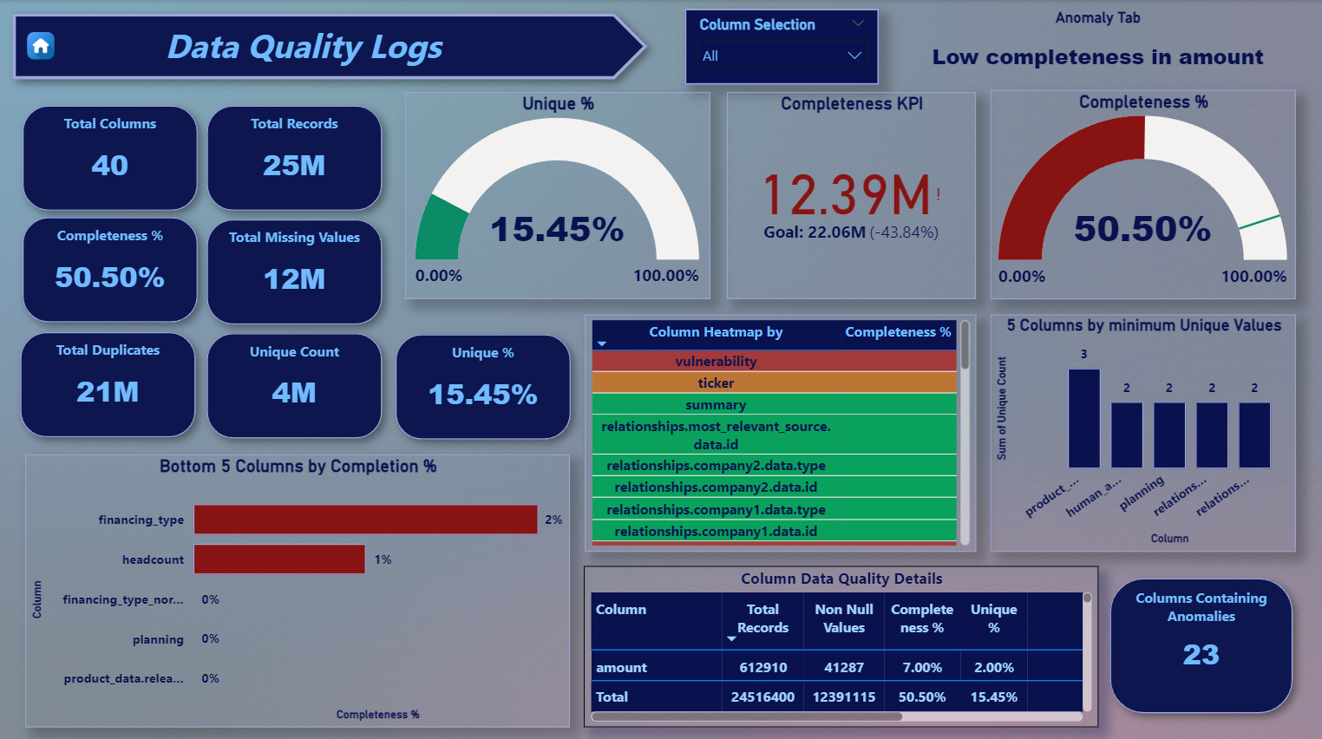

Slide 7

Thank You..

